Slide 1
Generative Adversarial Networks
Leonard Garcia
Francisco Gastelum
Jose Mierzejewski

Slide 2
Overview
Background/How GANs work
Application of GANs
Implementation

Slide 3
This Person Does Not Exist
https://thispersondoesnotexist.com/

Slide 4
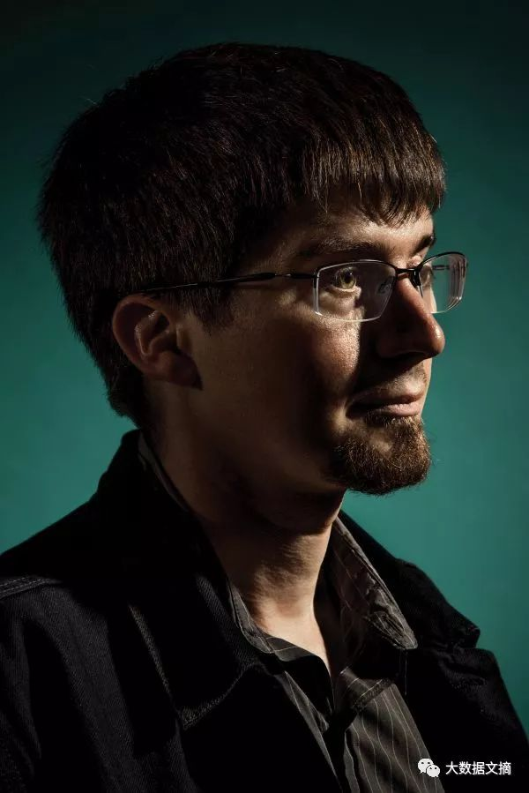
Generative Adversarial Networks (GANs)
First introduced by Ian Goodfellow et al. in 2014
“Generative Adversarial Nets”
Taken from:
www.hqew.net%2Fnews%2Fnews-35909&psig=AOvVaw3Wziiz3dkILntAN5N2t0yy&ust=1638826732398000&source=images&cd=vfe&ved=0CAwQjhxqFwoTCJjk28PPzfQCFQAAAAAdAAAAABAD

Slide 5
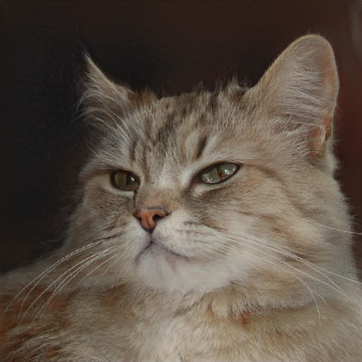
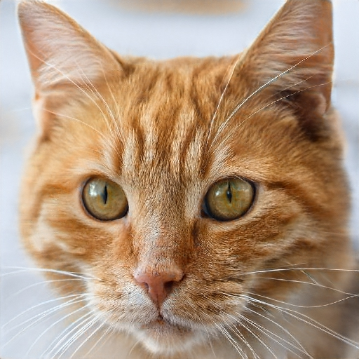
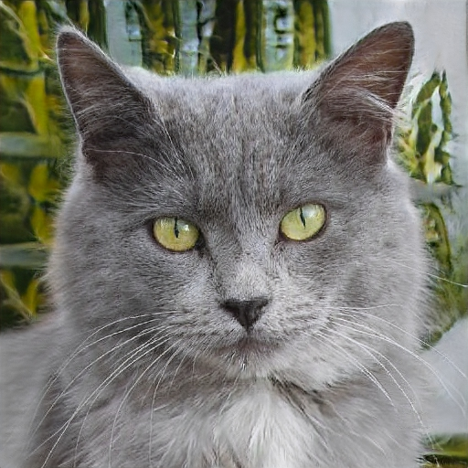
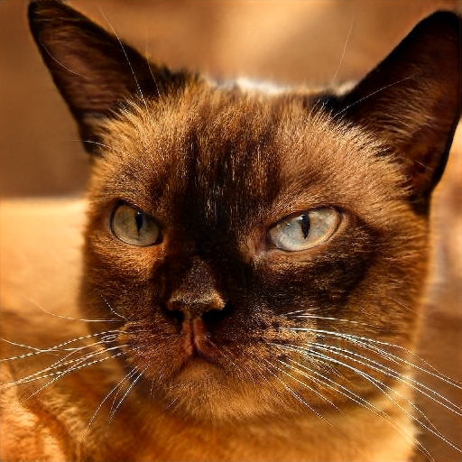
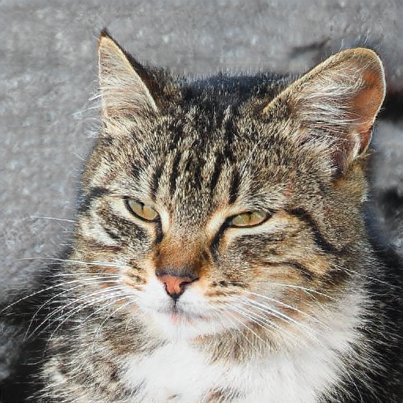
Generative Adversarial Networks (GANs)
Given a training set, GANs learn to generate new data with the same statistics
Generative
Network
GAN

Slide 6
Generative Adversarial Networks (GANs)
Two neural networks competing against each other in a zero-sum game framework
Generator Network
Discriminator Network
Generative
Network
Discriminative
Network
Generates fake samples
Determines if a sample is real or fake

Slide 7
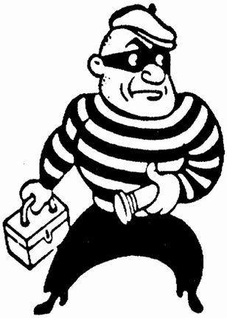
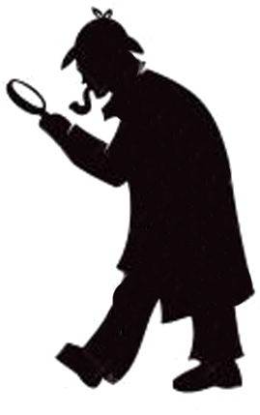
Generative Adversarial Networks (GANs)
“The generative model can be thought of as analogous to a team of counterfeiters, trying to produce fake currency and use it without detection, while the discriminative model is analogous to the police, trying to detect the counterfeit currency.”
Generator
Discriminator

Slide 8
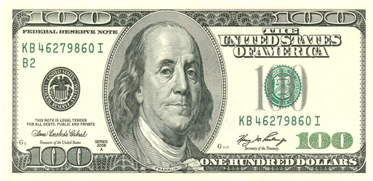
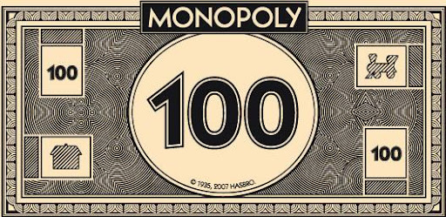
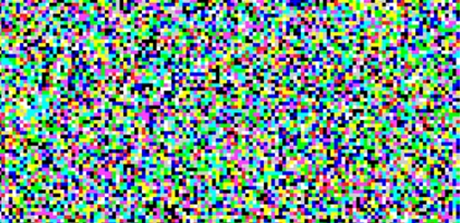
Generative Adversarial Networks (GANs)
Generator
Discriminator

Slide 9
Generative Adversarial Networks (GANs)
Generator
Discriminator

Slide 10
Generative Adversarial Networks (GANs)
Generator
Discriminator

Slide 11
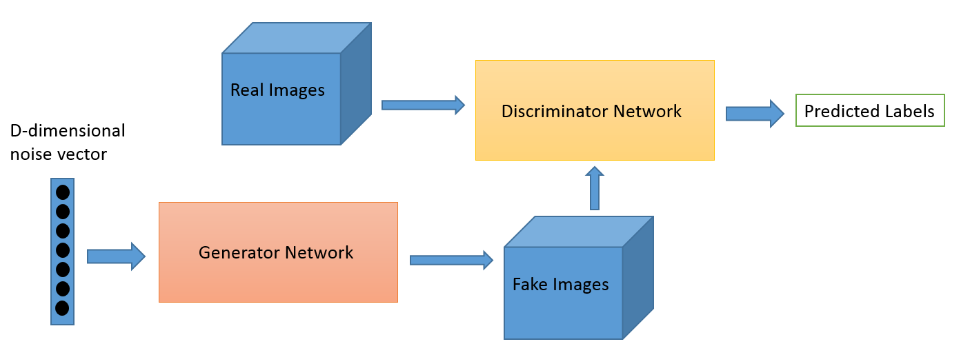
GANs

Slide 12
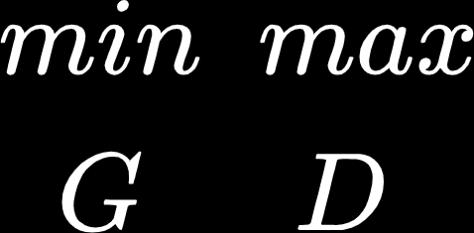
D and G play the following two-player minimax game with value function V(G,D):

Slide 13
D and G play the following two-player minimax game with value function V(G,D):
D
D(x)
x
D(G(z))
z
G(z)
G

Slide 14
D and G play the following two-player minimax game with value function V(G,D):
D
D(x)
x
D(G(z))
z
G(z)
G

Slide 15
D and G play the following two-player minimax game with value function V(G,D):
D(x) = probability that x came from the data rather than p_{g} (generator’s distribution)
Train D to maximize the probability of assigning the correct label to both training examples and samples from G

Slide 16
D and G play the following two-player minimax game with value function V(G,D):
D(x) = probability that x came from the data rather than p_{g} (generator’s distribution)
Train D to maximize the probability of assigning the correct label to both training examples and samples from G
Simultaneously train G to minimize log(1-D(G(Z))

Slide 17
Forward Propagation (generation and classification)
The generator produces fake data from random inputs
Discriminator separates true data from fake data
Generative
Network
Discriminative
Network
Update generator’s weights to increase classification error
Update discriminator’s weights to decrease classification error
Backward Propagation (adversarial training)

Slide 18
Forward Propagation (generation and classification)
The generator produces fake data from random inputs
Discriminator separates true data from fake data
Generative
Network
Discriminative
Network
Update generator’s weights to increase classification error
Update discriminator’s weights to decrease classification error
Backward Propagation (adversarial training)

Slide 19
Forward Propagation (generation and classification)
The generator produces fake data from random inputs
Discriminator separates true data from fake data
Generative
Network
Discriminative
Network
Update generator’s weights to increase classification error
Update discriminator’s weights to decrease classification error
Backward Propagation (adversarial training)

Slide 20
Generative Adversarial Network Applications

Slide 21
Applications
Cartoons and Video Games
Photography and Art
Advertisements
Science
Fashion
Create more data for neural networks
Much more...

Slide 22
Negative Side of Generative Adversarial Networks
Raises many concerns:
Can produce incriminating photos/videos
Can be used for defamation purposes
Used to create images of nonexistent people for different purposes
Much more...

Slide 23
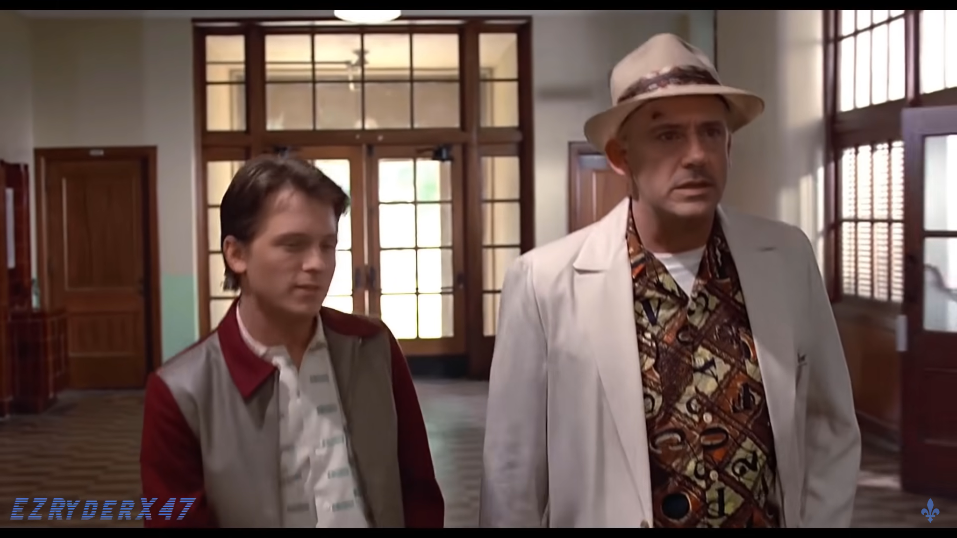
Deepfake
Replace a person in an image or video, with the likeness of another
Can create damaging photos and videos
Laws enacted to protect against deepfakes
Screenshot taken from Youtube video- “Robert Downey Jr and Tom Holland in Back to the future”
https://youtu.be/8OJnkJqkyio

Slide 24
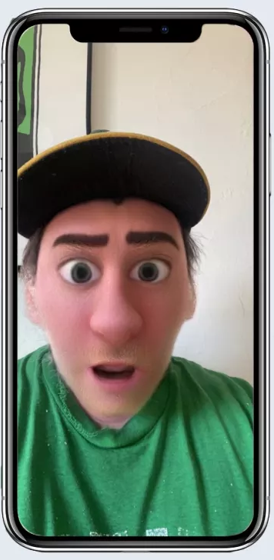
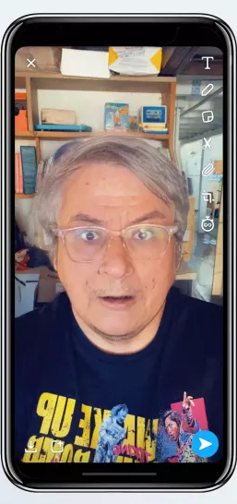
Snapchat Filters and Lenses
Many different filters with different outcomes
Ex. old and anime style filters to the right
Changes the user’s face to appear as a different version of the original
Fun and simple to use
Images taken from https://www.tomsguide.com/round-up/best-snapchat-filters a website ranking the best snapchat filters

Slide 25
Analyze/Detect Unwanted Encodings
Does not alter an image, instead it detects changes
Can be useful for cybersecurity purposes
Can also be used for personal use

